Slide 1


Vehicle Driver’s Drowsiness Detection
Under the Guidance of : Submitted By:
Prof. Damanpreet Singh Manshi (GCS/1930034)
CSE SLIET Raushan Raj (GCS/1930035)

Slide 2












Contents
Introduction
Motivation
Objective
Flow Chart
Facial Landmark
EAR & MAR Calculation
Setup
Execution
Test Cases
Dependencies
Future Scope

Slide 3

Introduction
Driver’s drowsiness has been one of the major causes of road accidents and can lead to severe physical injuries, deaths and significant economic losses.
To avoid this, we present a system for driver drowsiness detection that is a vehicle safety technology which helps prevent accidents caused by the driver getting drowsy.

Slide 4

Motivation
NHTSA Estimates 100,000 drowsiness/fatigue related Crashes Annually.
Fatigue has been estimated to be involved in
10-40% of crashes on highways (rural Interstate).
An accident involving driver drowsiness has a high fatality rate because the perception, recognition, and vehicle control abilities reduces sharply while falling asleep.
Driver drowsiness detection technologies can reduce the risk of a catastrophic accident by warning the driver of his/her drowsiness.

Slide 5

Objective
To investigate the physical changes on the face of driver due to fatigue and drowsiness.
To develop a system that detects drowsiness and yawning, then alert by ringing an alarm.
To deploy the system on Raspberry Pi 4.

Slide 6
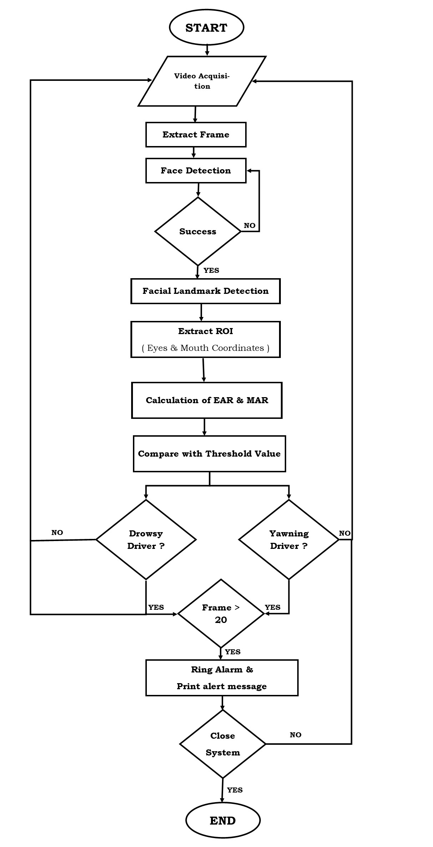

Flow Diagram

Slide 7
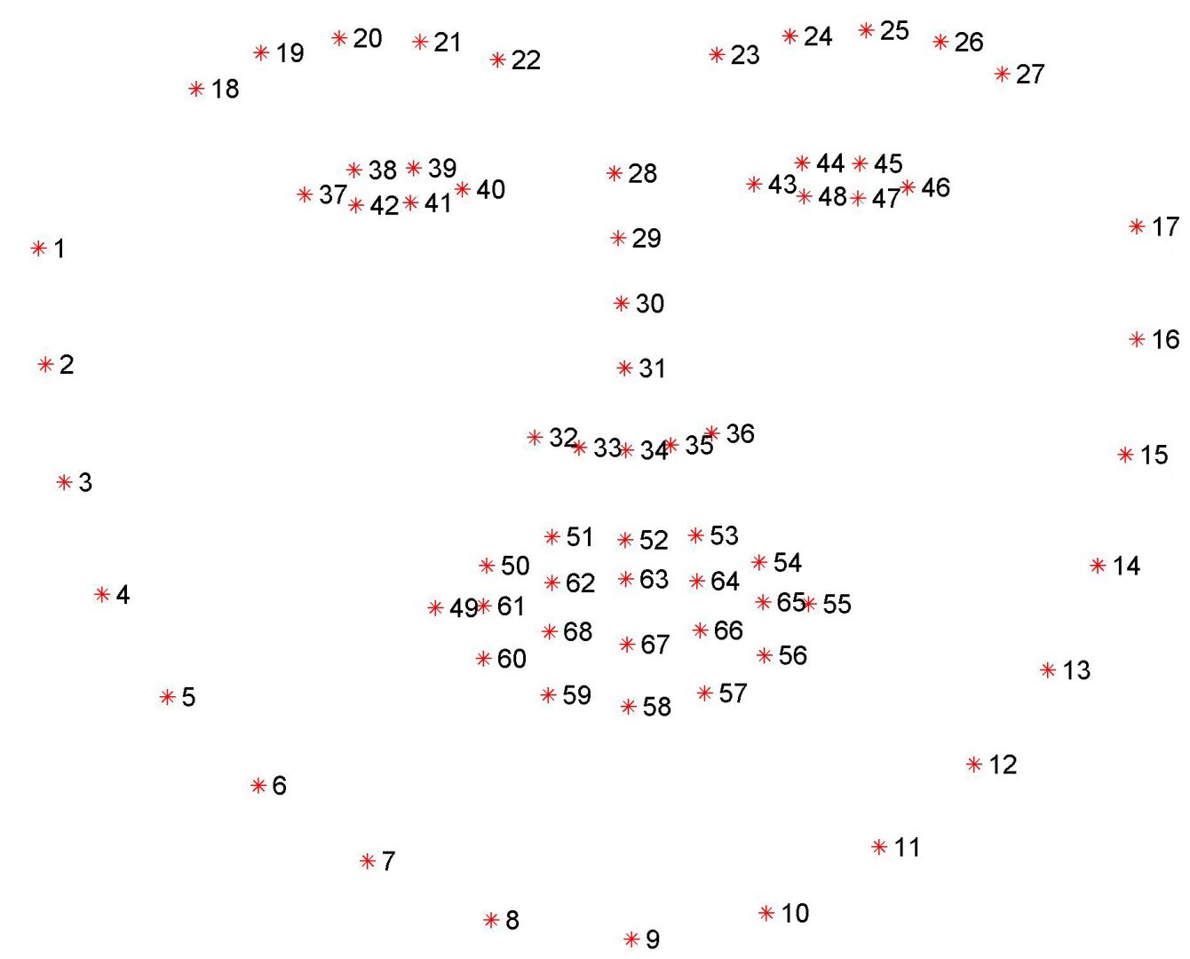

Facial Landmarks
Facial Landmarks Shape Predictor maps face into 68 coordinates. From these 68 coordinates, the required coordinates are extracted for further manipulation.

Slide 8
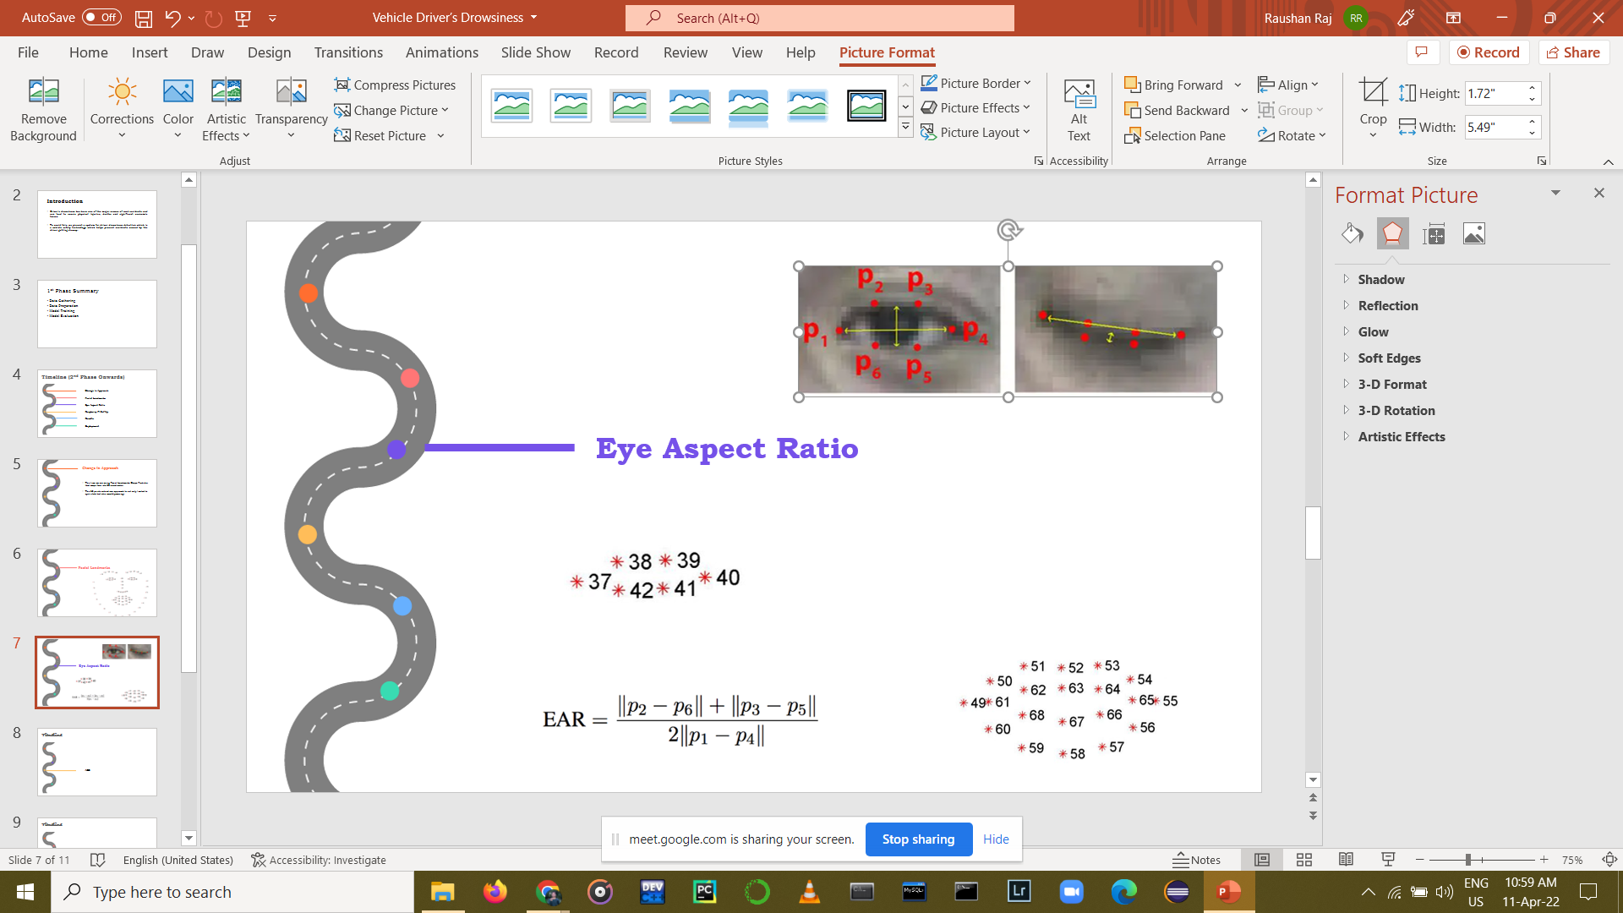

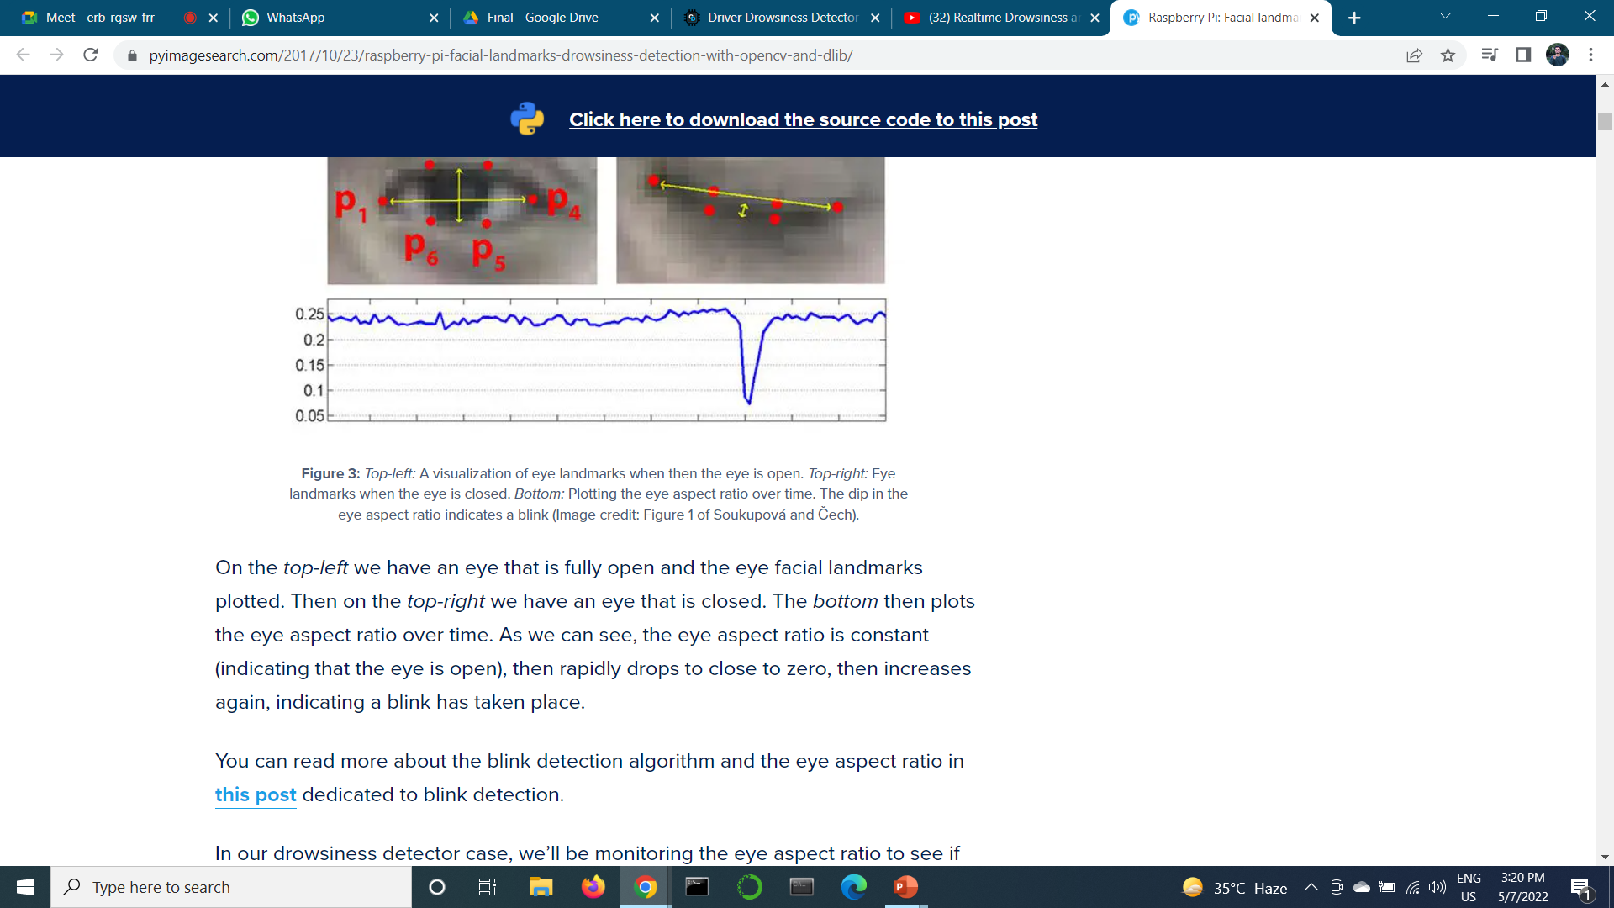
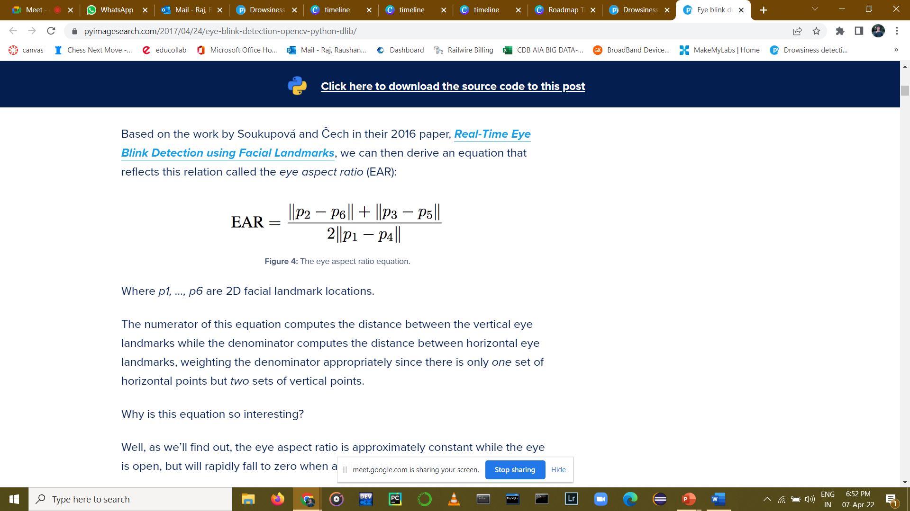
EAR Calculation
Threshold Value for Eye is 0.25
Eye Coordinates

Slide 9
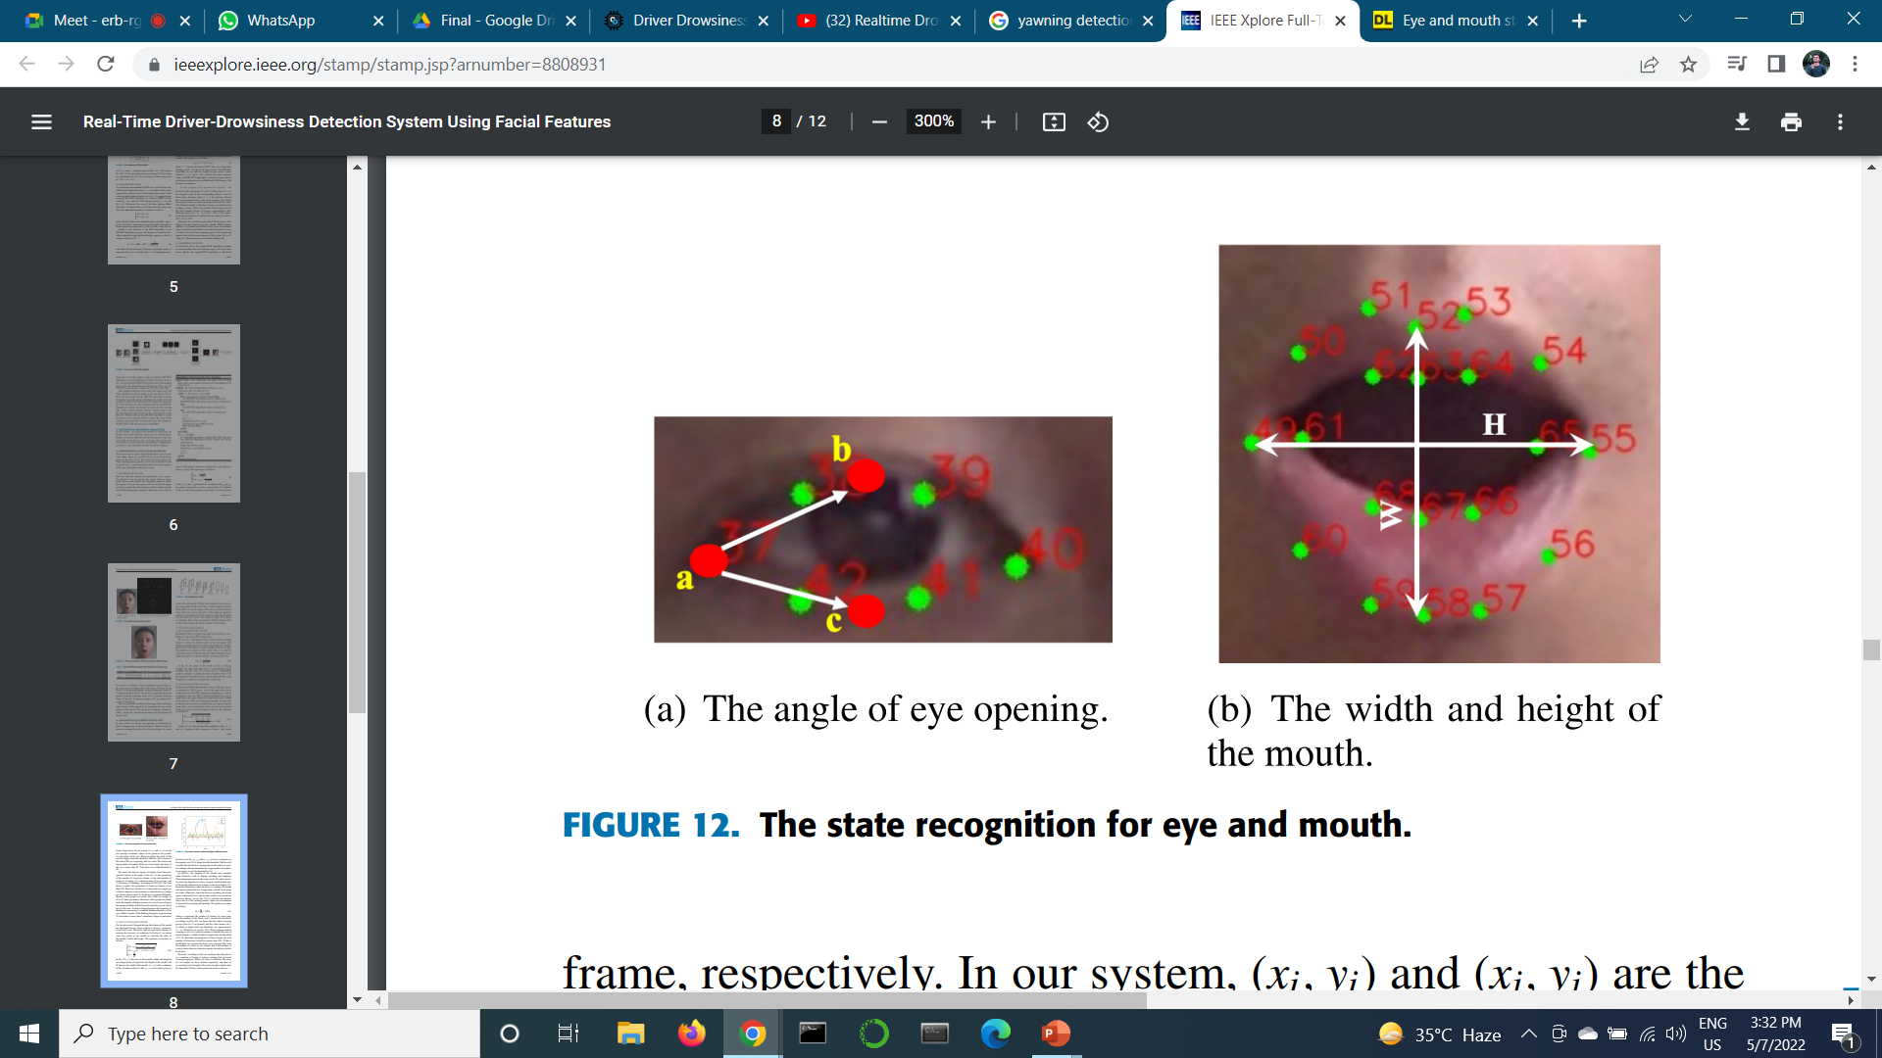
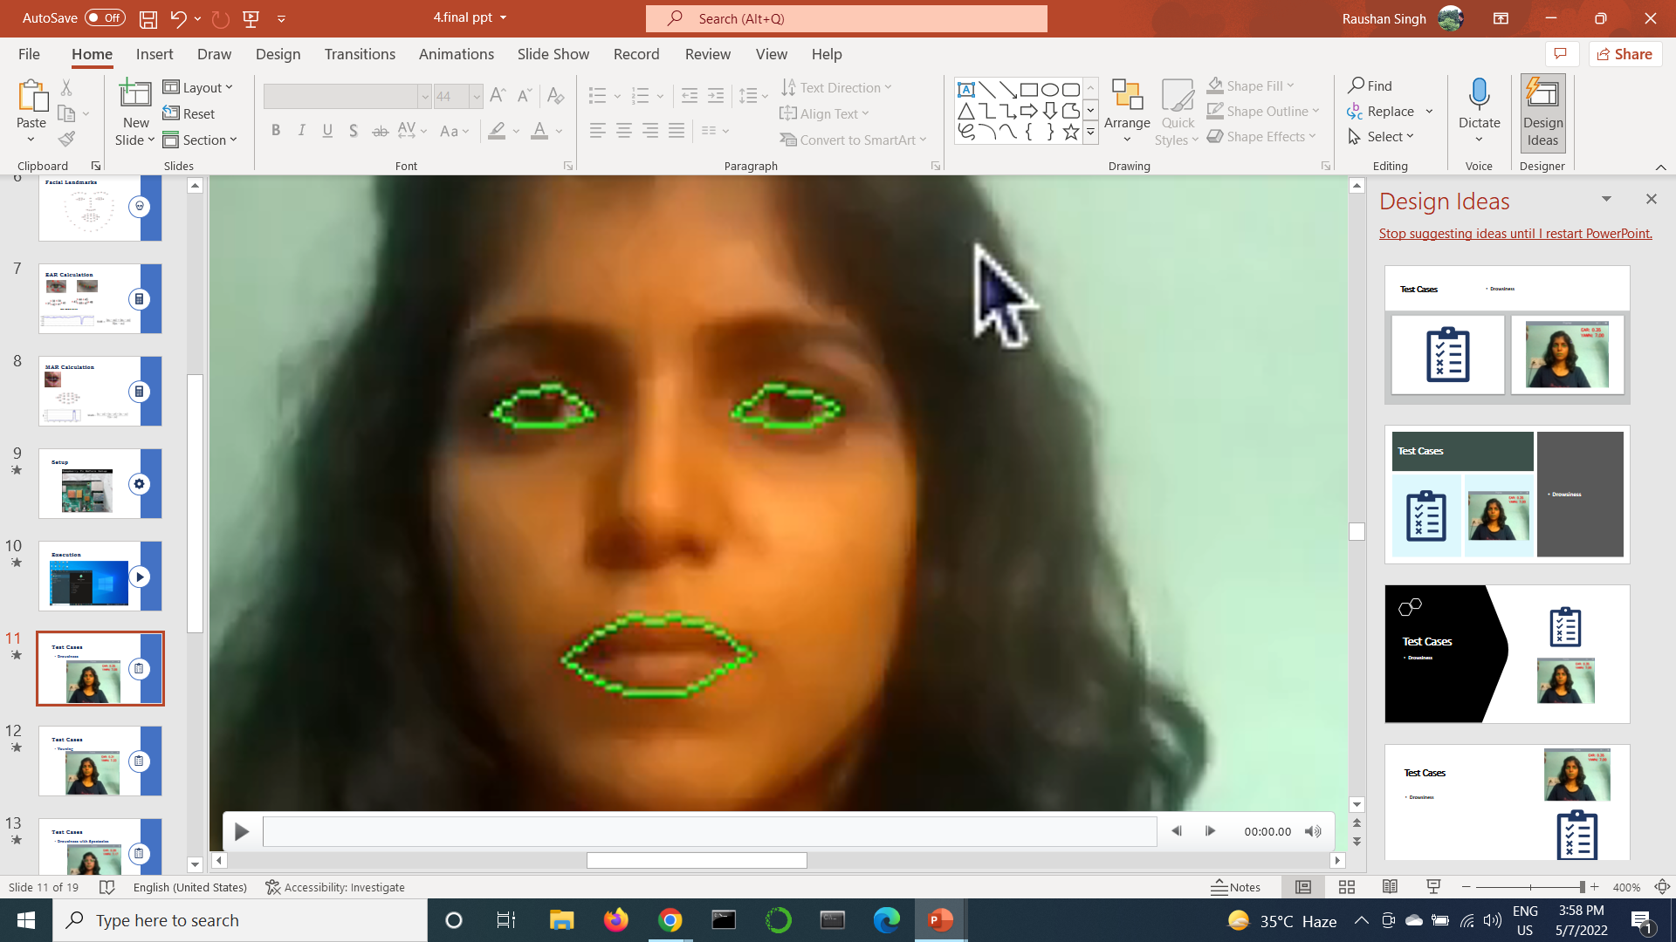
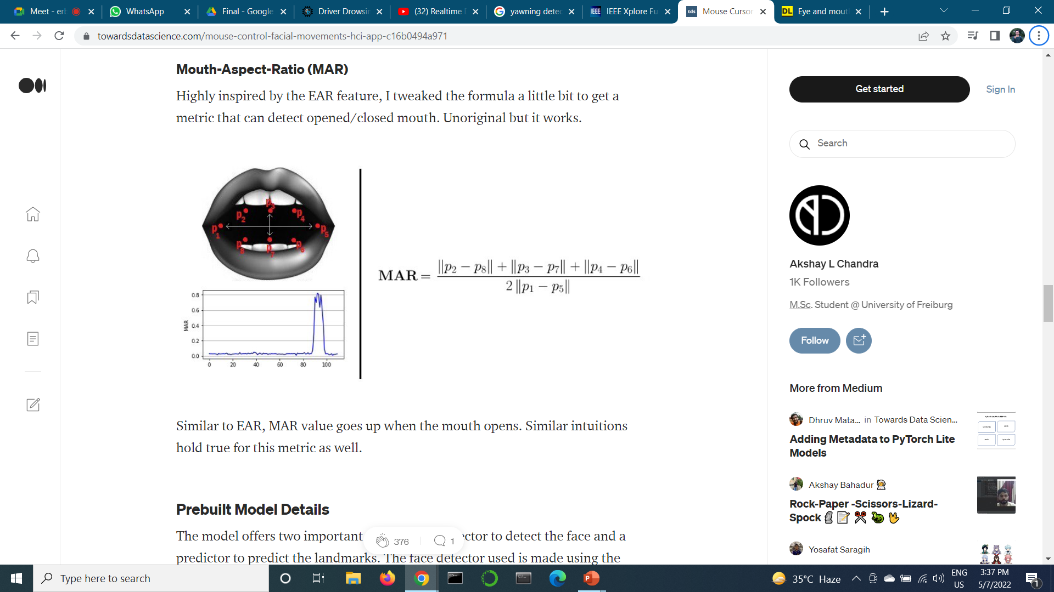
MAR Calculation
Threshold Value for Mouth is 17
21
20
19
18
Mouth Coordinates
17

Slide 10
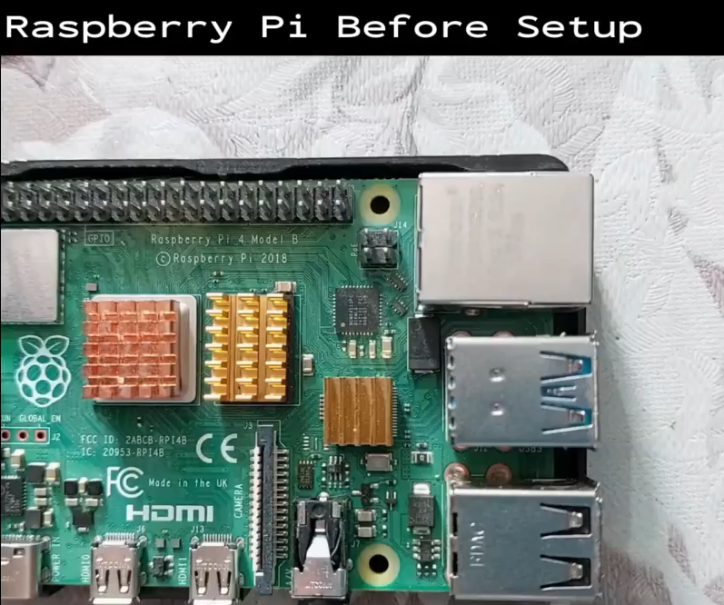

Setup

Slide 11
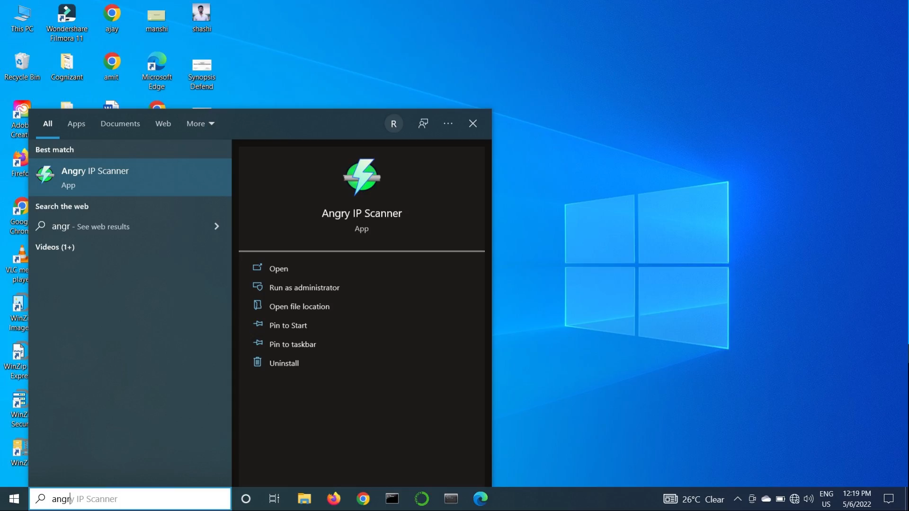

Execution

Slide 12
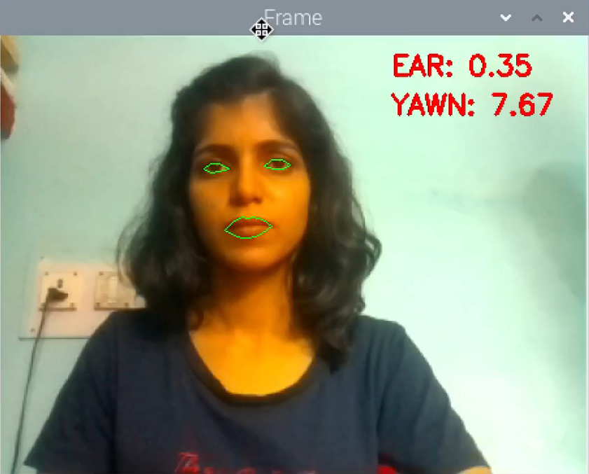

Test Cases
Normal

Slide 13
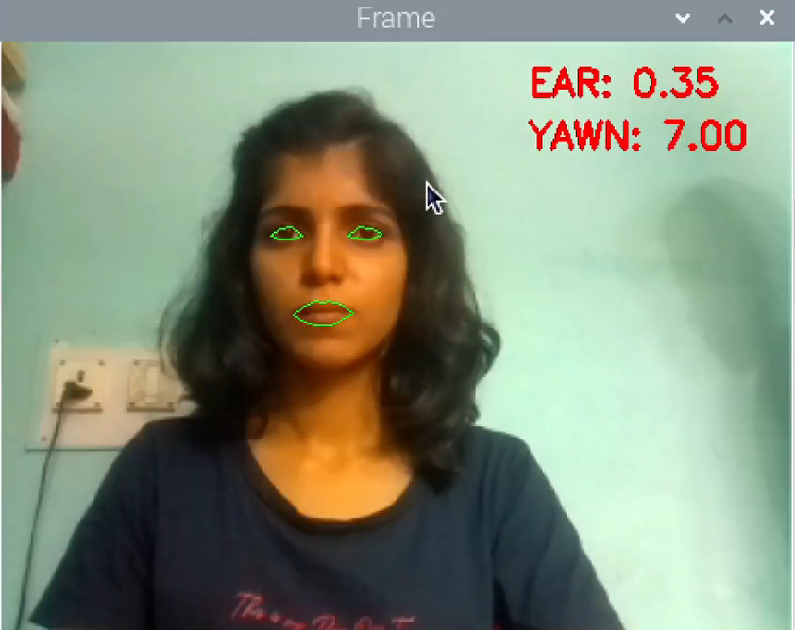
Test Cases
Drowsiness

Slide 14
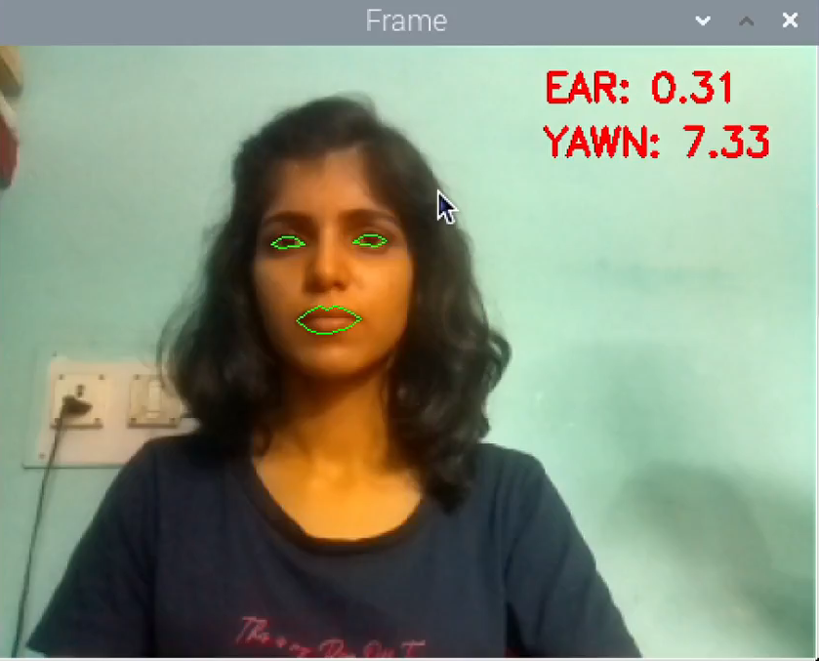
Test Cases
Yawning

Slide 15
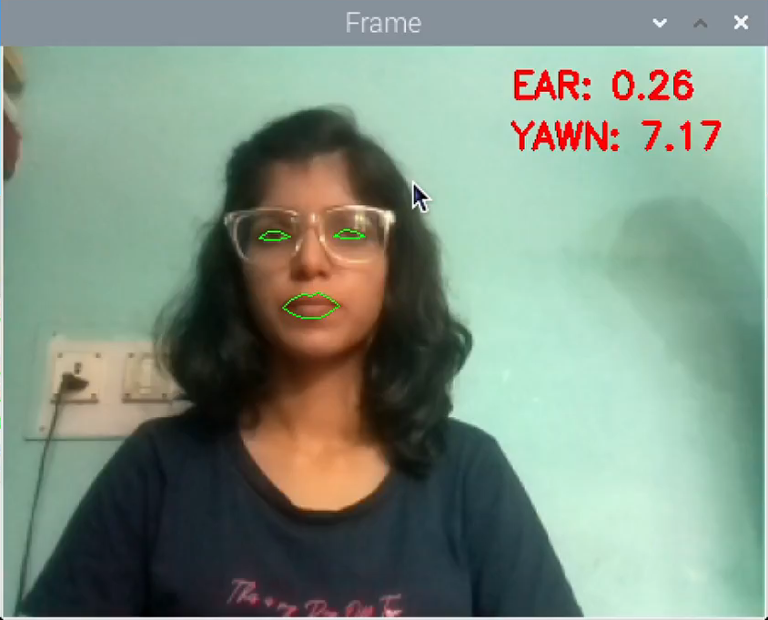
Test Cases
Drowsiness with Spectacles

Slide 16
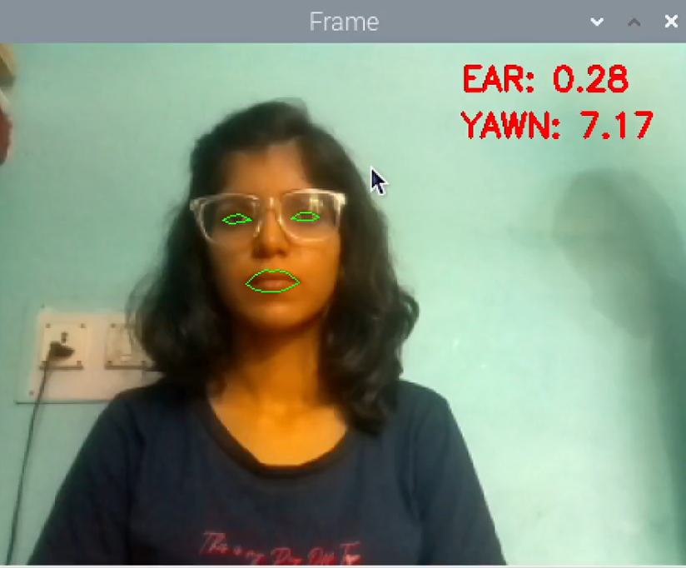
Test Cases
Yawning with Spectacles

Slide 17
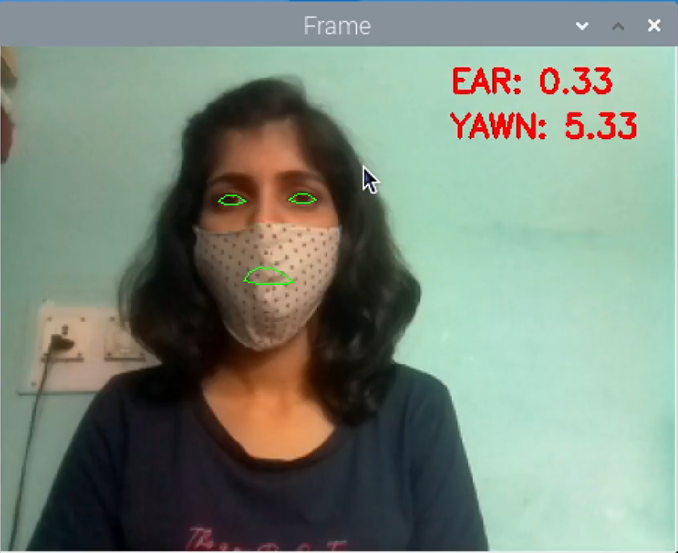
Test Cases
Drowsiness with Mask

Slide 18
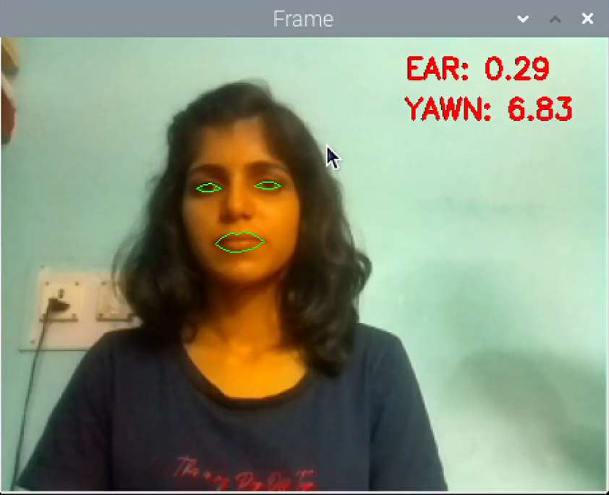
Test Cases
Talking

Slide 19
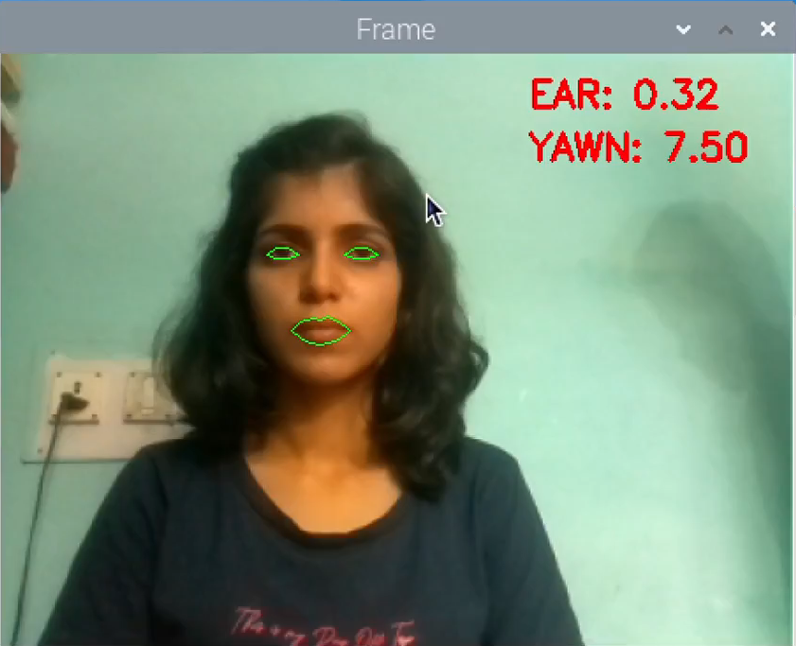
Test Cases
Blinking

Slide 20

Test Cases
Smiling

Slide 21
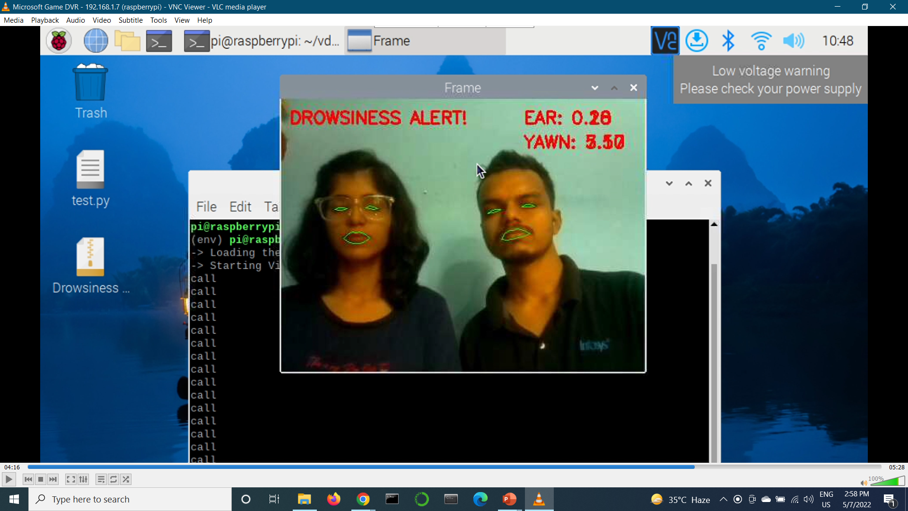
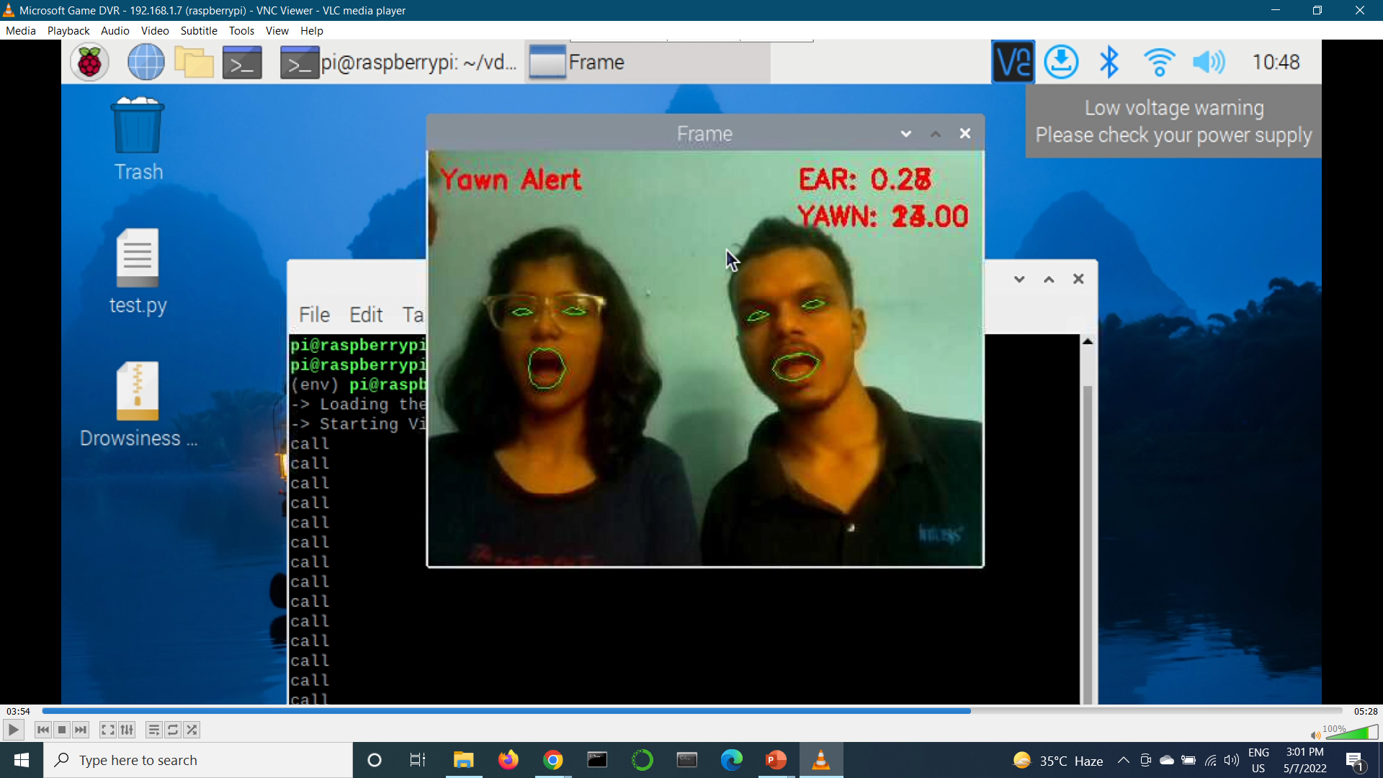
Test Cases
Multiple Faces

Slide 22

Dependencies
Placement of device in the vehicle.
Distance of camera from driver face.
Face covering objects.
Multiple faces in the frame.

Slide 23

Future Scope
Design and fit a motor driven system, synchronize it with the existing system so that the vehicle will slow down automatically after getting the warning signal.
Along with alerting the driver, informing the third party like owner, police etc. in case of emergency.

Slide 24

Thank You !!

